Slide 1

Pa Lions MD-14 State
Diabetic Coordinator
MaryAnn Fleeger

Slide 2

What Is Diabetes
Diabetes is a disease that occurs when your blood glucose, also called blood sugar, is too high. Glucose is your body’s main source of energy. Your body can make glucose, but glucose also comes from the food you eat.
Insulin is a hormone made by the pancreas that helps glucose get into your cells to be used for energy. If you have diabetes, your body doesn’t make enough—or any—insulin, or doesn’t use insulin properly. Glucose then stays in your blood and doesn’t reach your cells.
Diabetes raises the risk for damage to the eyes, kidneys, nerves, and heart. Diabetes is also linked to some types of cancer. Taking steps to prevent or manage diabetes may lower your risk of developing diabetes health problems.
https://www.niddk.nih.gov/health-information/diabetes/overview/what-is-diabetes

Slide 3

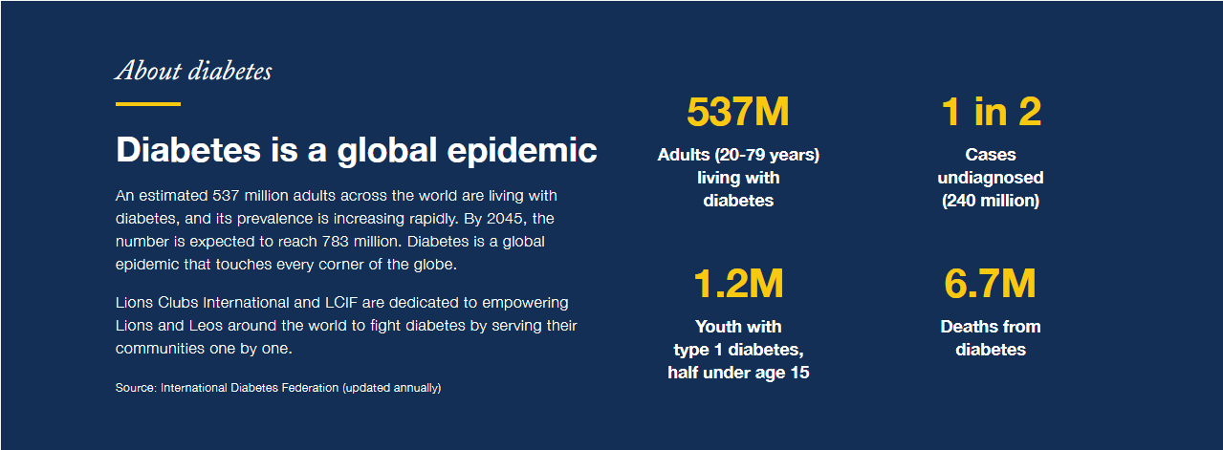
World Statistics
About Diabetes
Diabetes is a global epidemic
An estimated 537 million adults across the world are living with diabetes, and its prevalence is increasing rapidly. By 2045, the number is expected to reach 783 million. Diabetes is a global epidemic that touches every corner of the globe.
Lions International and LCIF are dedicated to empowering Lions and Leos around the world to fight diabetes by serving their communities one by one.
537 Million adults with diabetes, 1.2 Million youth with type 1 under 15 yrs of age.
1 in 2 cases undiagnosed, 6.7 Million deaths from diabetes complications.
Notes:
Now 589M adults as of 2024

Slide 4
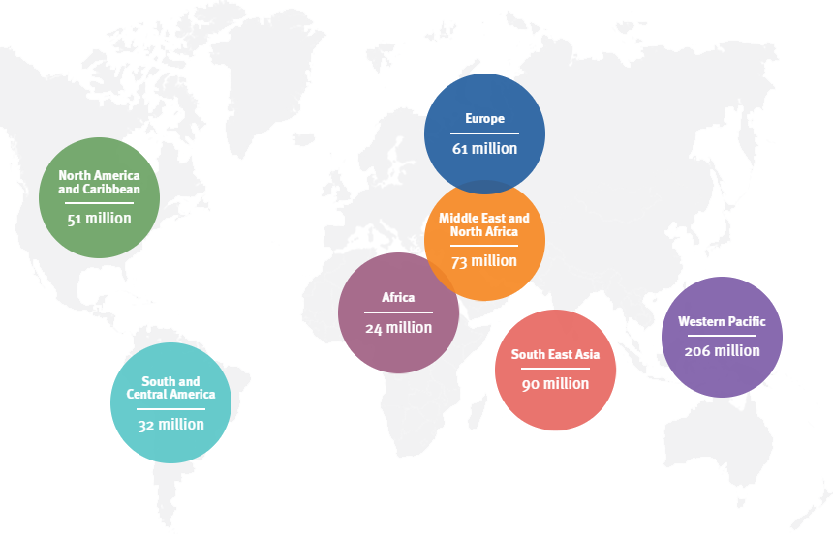
Diabetes Worldwide

Slide 5

The Role of Insulin
Insulin chemistry and etymology:
Insulin is a protein chain or peptide hormone. There are 51 amino acids in an insulin molecule. It has a molecular weight of 5808 Da.
Insulin is produced in the islets of Langerhans in the pancreas. The name insulin comes from the Latin ''insula'' for "island" from the cells that produce the hormone in the pancreas.
Insulin has several broad actions including:
It causes the cells in the liver, muscle, and fat tissue to take up glucose from blood and convert it to glycogen that can be stored in the liver and muscles
Insulin also prevents the utilization of fat as an energy source. In absence of insulin or in conditions where insulin is low glucose is not taken up by body cells, and the body begins to use fat as an energy source
Insulin also controls other body systems and regulates the amino acid uptake by body cells
It has several other anabolic effects throughout the body as well

Slide 6
The Role of Glucose
Glucose – a sugar – s the main source of energy for the cells that make up muscles and other tissues
Glucose comes from 2 major sources: food and your liver
Your liver stores glucose as glycogen
Sugar is absorbed into the bloodstream, where it enters the cells with the help of the insulin. (Think of a key to a locked door)
When glucose levels are low, such as you haven’t eaten in a while the liver breaks down sored glycogen into glucose to keep levels within normal range.

Slide 7
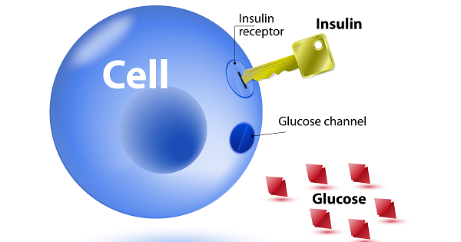

Slide 8

Symptoms of Diabetes
Thirst
Frequent Urination
Bed Wetting in children that didn’t previous have an issue
Extreme Hunger
Irritability mood swings
Fatigue
Blurred Vision
Fruity Breath
Unexplained/ Unplanned weight loss
Slow Healing
Frequent Infections
Numbness or Tingling of hands and feet
Areas of darkened skin, usually in armpits and neck.

Slide 9

Types of Diabetes
There are 5 main types
Pre- Diabetes
Gestational
Type 1
Type 1.5
Type 2

Slide 10

Pre - Diabetes
Prediabetes is a condition in which your blood glucose (Sugar) levels are higher than normal but not high enough to be called Diabetes.
1 in 3 Adults have been diagnosed as prediabetic and are at higher risk of type 2 diabetes

Slide 11
Gestational Diabetes
Gestational Diabetes is diabetes being diagnosed during pregnancy. Like other types, Gestational Diabetes affects how your cells use sugar.
Can affect both your pregnancy and your baby’s health
For most gestational diabetes doesn’t cause noticeable signs and or symptoms.
Risk known to Gestational Diabetes is polycystic ovary syndrome

Slide 12
Type 1
Type 1 diabetes, Formally many know as Juvenile diabetes, or insulin dependent diabetes, Is a chronic condition in which the pancreas produces little to no insulin. Insulin is needed to allow sugar to ender cells to produce and be used as energy (Like a key to a locked door)
Usually diagnosed in childhood or early adulthood, it can still develop in adults

Slide 13
Type 1.5
Type 1.5, also called laten autoimmune diabetes (LADA), is a condition that shares characteristics of both Type 1 and Type 2
LADA unlike Type 2 is nonreversible as it is an autoimmune disease
Often misdiagnosed as Type 2. If you have a active life and healthy weight range, and diagnosed as Type 2, There is a chance you are Type 1.5 (LADA)
Currently no way to prevent Type 1.5

Slide 14
Type 2
Type 2 (used to be called Adult On-set) is an impairment in the way the body regulates and uses sugar (Glucose) as fuel. This chronic condition results in too much sugar circulating the bloodstream. Eventually high sugar levels can lead to disorders of the circulatory, nervous, and immune systems.
2 factors at work, Pancreas does not produce enough insulin, and cells respond poorly to insulin and take in less sugar.
More common in older adults but increase in the number of children overweight and obese has led to more cases of Type 2 in children. Adolescent girls are more likely to develop type 2 diabetes than are adolescent boys
No set cure for type 2, but losing weight, healthier diet, and exercise can help manage the disease.
Could also be prescribed medications or insulin

Slide 15

Complications
Heart and blood vessel disease
Nerve Damage (Neuropathy)
Kidney Damage (Nephropathy)
Eye Damage
Foot Damage
Skin and Mouth conditions
Pregnancy Complications
Slow Healing
Hearing Impairment
Sleep Apnea
Dementia
High Blood Pressure
High Cholesterol
Stroke
Nonalcoholic fatty liver disease
Blindness
Amputation
Affects The Baby (Gestational)
Excessive Birth weight
Early Birth (Preterm)
Breathing Difficulties
Low Blood Sugar ( Hypoglycemia)
Obesity and type 2 later in life
Stillbirth

Slide 16

Warning Signs
Numbness in hands and feet, a prickling, tingling, or painful sensation
Increased Urination can be typically more than 3 liters a day as compared to 1 – 2 liters
Unexplained/ Unplanned Weight loss can happen rapidly because of the body’s inability to absorb glucose properly
Blurry Vision can happen when blood glucose levels reach dangerous levels resulting in damage to blood vessels in the eye
Unexplained Tiredness / Fatigue is one of the most prevalent and frustrating symptoms of diabetes
Unquenchable Thirst is a result of high blood sugars causing dry mouth and dehydration

Slide 17
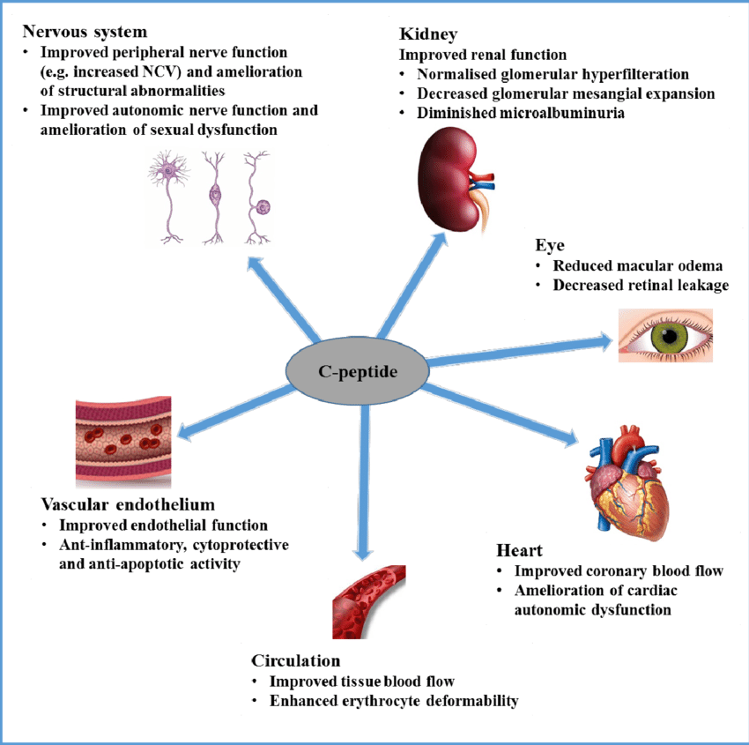
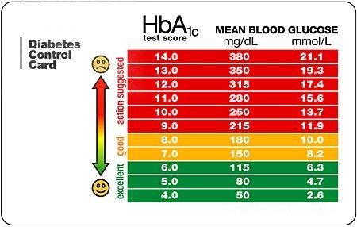
Testing for Diabetes
C-peptide
is a peptide that the pancreas produces during the process of making insulin. It's released into the bloodstream at the same time as insulin in equal amounts and doesn't affect blood glucose levels. However, C-peptide stays in the blood longer than insulin, making it easier to measure accurately. A C-peptide test can help doctors understand, monitor, and treat disorders related to insulin production, such as diabetes and hypoglycemia (low blood sugar)
A1C
The A1C test, also known as the hemoglobin A1C or HbA1c test, measures a person's average blood sugar levels over the previous three months. It's a blood test that measures the percentage of hemoglobin proteins in red blood cells that are coated with sugar, or glycated. The higher the percentage of glycated hemoglobin, the higher the person's blood sugar levels

Slide 18

Burden Of Diabetes In Pennsylvania
We have an epidemic in Pennsylvania.
Approximately 1,145,500 adults in Pennsylvania, or 11.1% of adult population, have diagnosed diabetes.
Every year, an estimated 61,000 adults in Pennsylvania are diagnosed with diabetes
Approximately 3,345,700 adults in Pennsylvania, or 33.4% of the adult population, have obesity

Slide 19

Who’s at Risk
Family History – If you have a mother, father, or sibling with diabetes you are more likely to develop diabetes
Ethnic Background – Diabetes is more commonly found among Pacific Islanders, American Indians, African Americans, Asian Americans, and Hispanic Americans.
Obesity – Being overweight can considerably increase the chance of developing diabetes.
Physically Inactive – Diabetes is more prevalent in those who do not exercise 20 – 30 minutes a day.
Previous Gestational Diagnosis – Those who experience Gestational diabetes are more prone to develop Type 2 Diabetes as an adult.
Age over 45
Birth weight and gestational diabetes - Can lead to a higher risk of type 2 later
Preterm Birth – Born before 39 – 42 weeks’ gestation have greater risk of type 2 diabetes

Slide 20

Reducing your RISK
Exercise Regularly – Get more exercise daily, preferably atleast 20-30 minutes
Reduce Total Carb Intake – Cut back on high carb foods such as bread, potatoes, rice, etc. No more than 200-225 carb grams per day
Drink Water as Primary Beverage – Drink 11 – 13 glasses of water daily
Reduce Portion Size at Meals – Use smaller plates at meal time and consume no more than 1500 – 180 calories a day
Cut Back on Sedentary Behaviors – Increase your activity and exercise levels such as gardening, walking, using stairs, join a health group.
Follow High Fiber Diet – Try to eat more high fiber foods such as blueberries, beans, oat bran, sweet potatoes, oranges, raisins, etc.

Slide 21
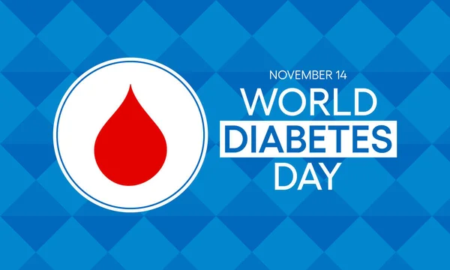

Slide 22

Resources
https://www.niddk.nih.gov/health-information/diabetes/overview/what-is-diabetes
https://www.mayoclinic.org/diseases-conditions/search-results?q=Diabetes
https://www.healthline.com/health/type-1-5-diabetes

Slide 24
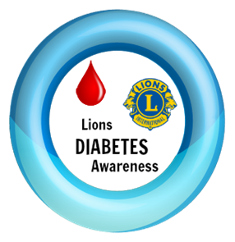
What As Lions Can We do

Slide 25
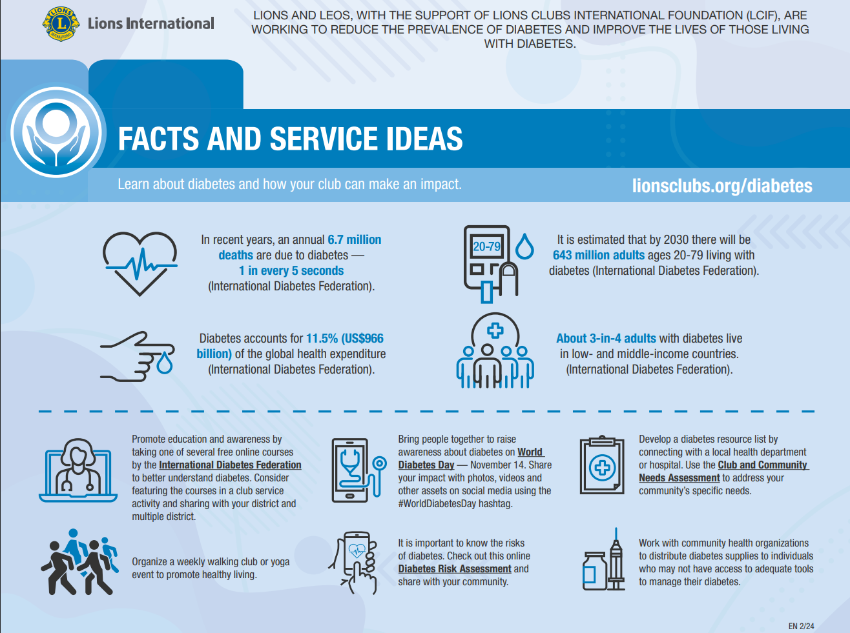


Slide 26
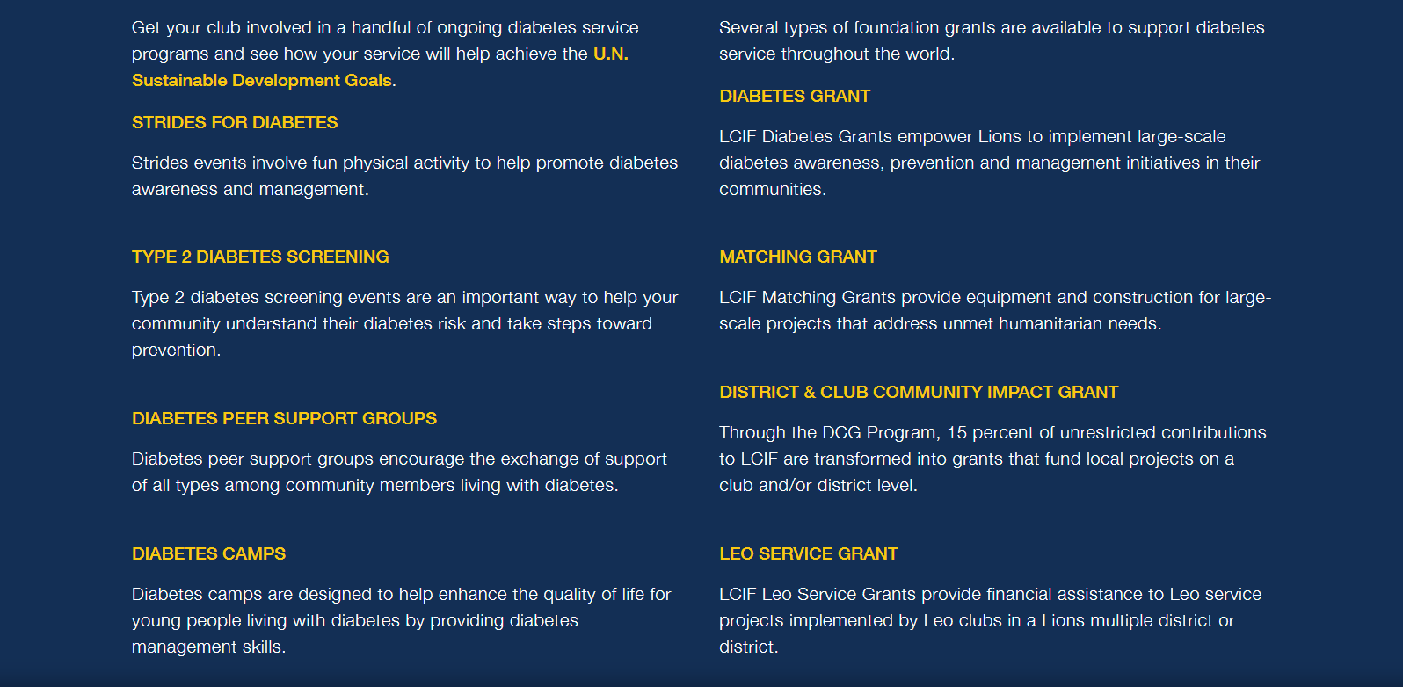
Programs
Grants

Slide 27
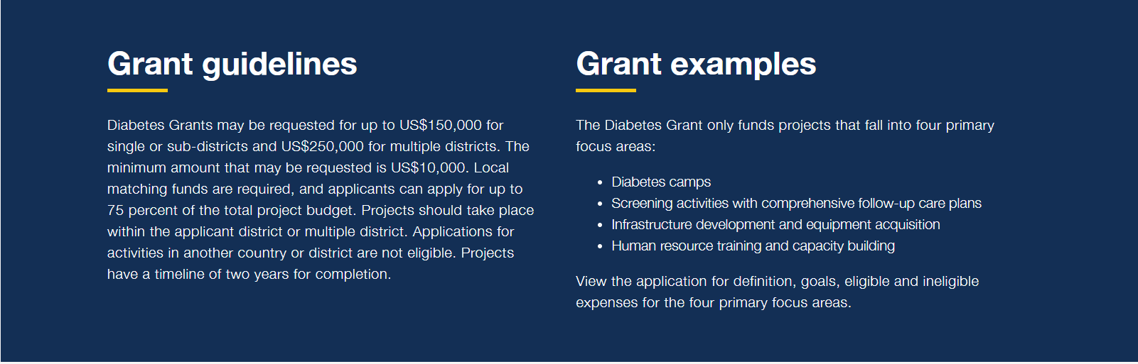

Slide 28
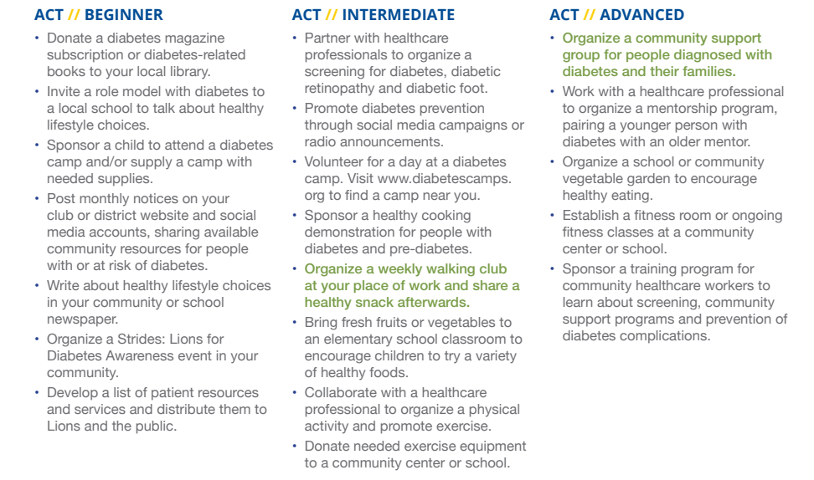

Slide 29

Thank You

