Slide 1


Studebaker Blorbo Society
Year 1

Slide 2

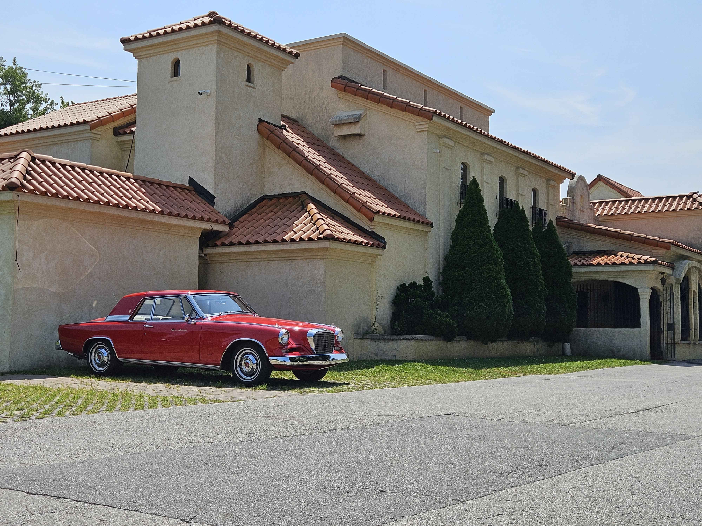
Our members make us who we are <3
Thank you to everyone who made this first year of the SBS an absolute blast.
Avery
Christian N
Creeg
Kingpleb
Martin Luther
Newt
Prince Tiwari
Stryker
Toleratesurbs
Tsubodai
“Took the GT Hawk for Mexican food today” Martin Luther

Slide 3

The SBS Timeline
Creation of the SBS
I forgot about the SBS
I remembered again
The Reddit post explodes
Modern day
Brought to you by our very own Tsubodai

Slide 4


Awards
Tsubodai: SHITPOSTER
Martin Luther: VEHICLEMEISER
Pleb: FEMBOY
Creeg: OLD MAN!
Avery: FOX

Slide 5
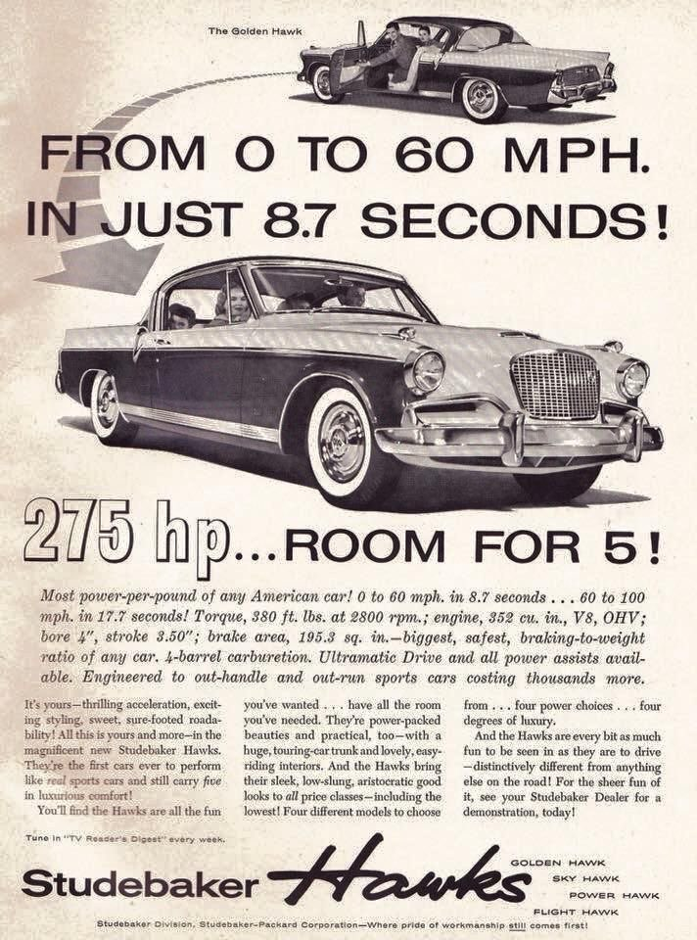
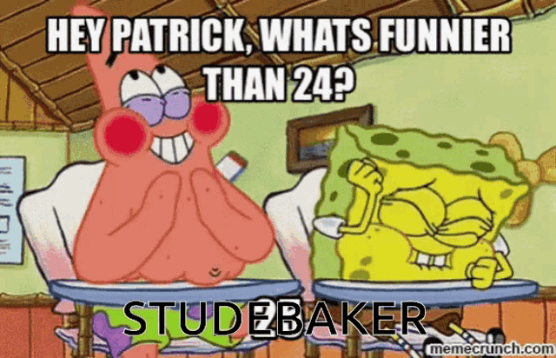
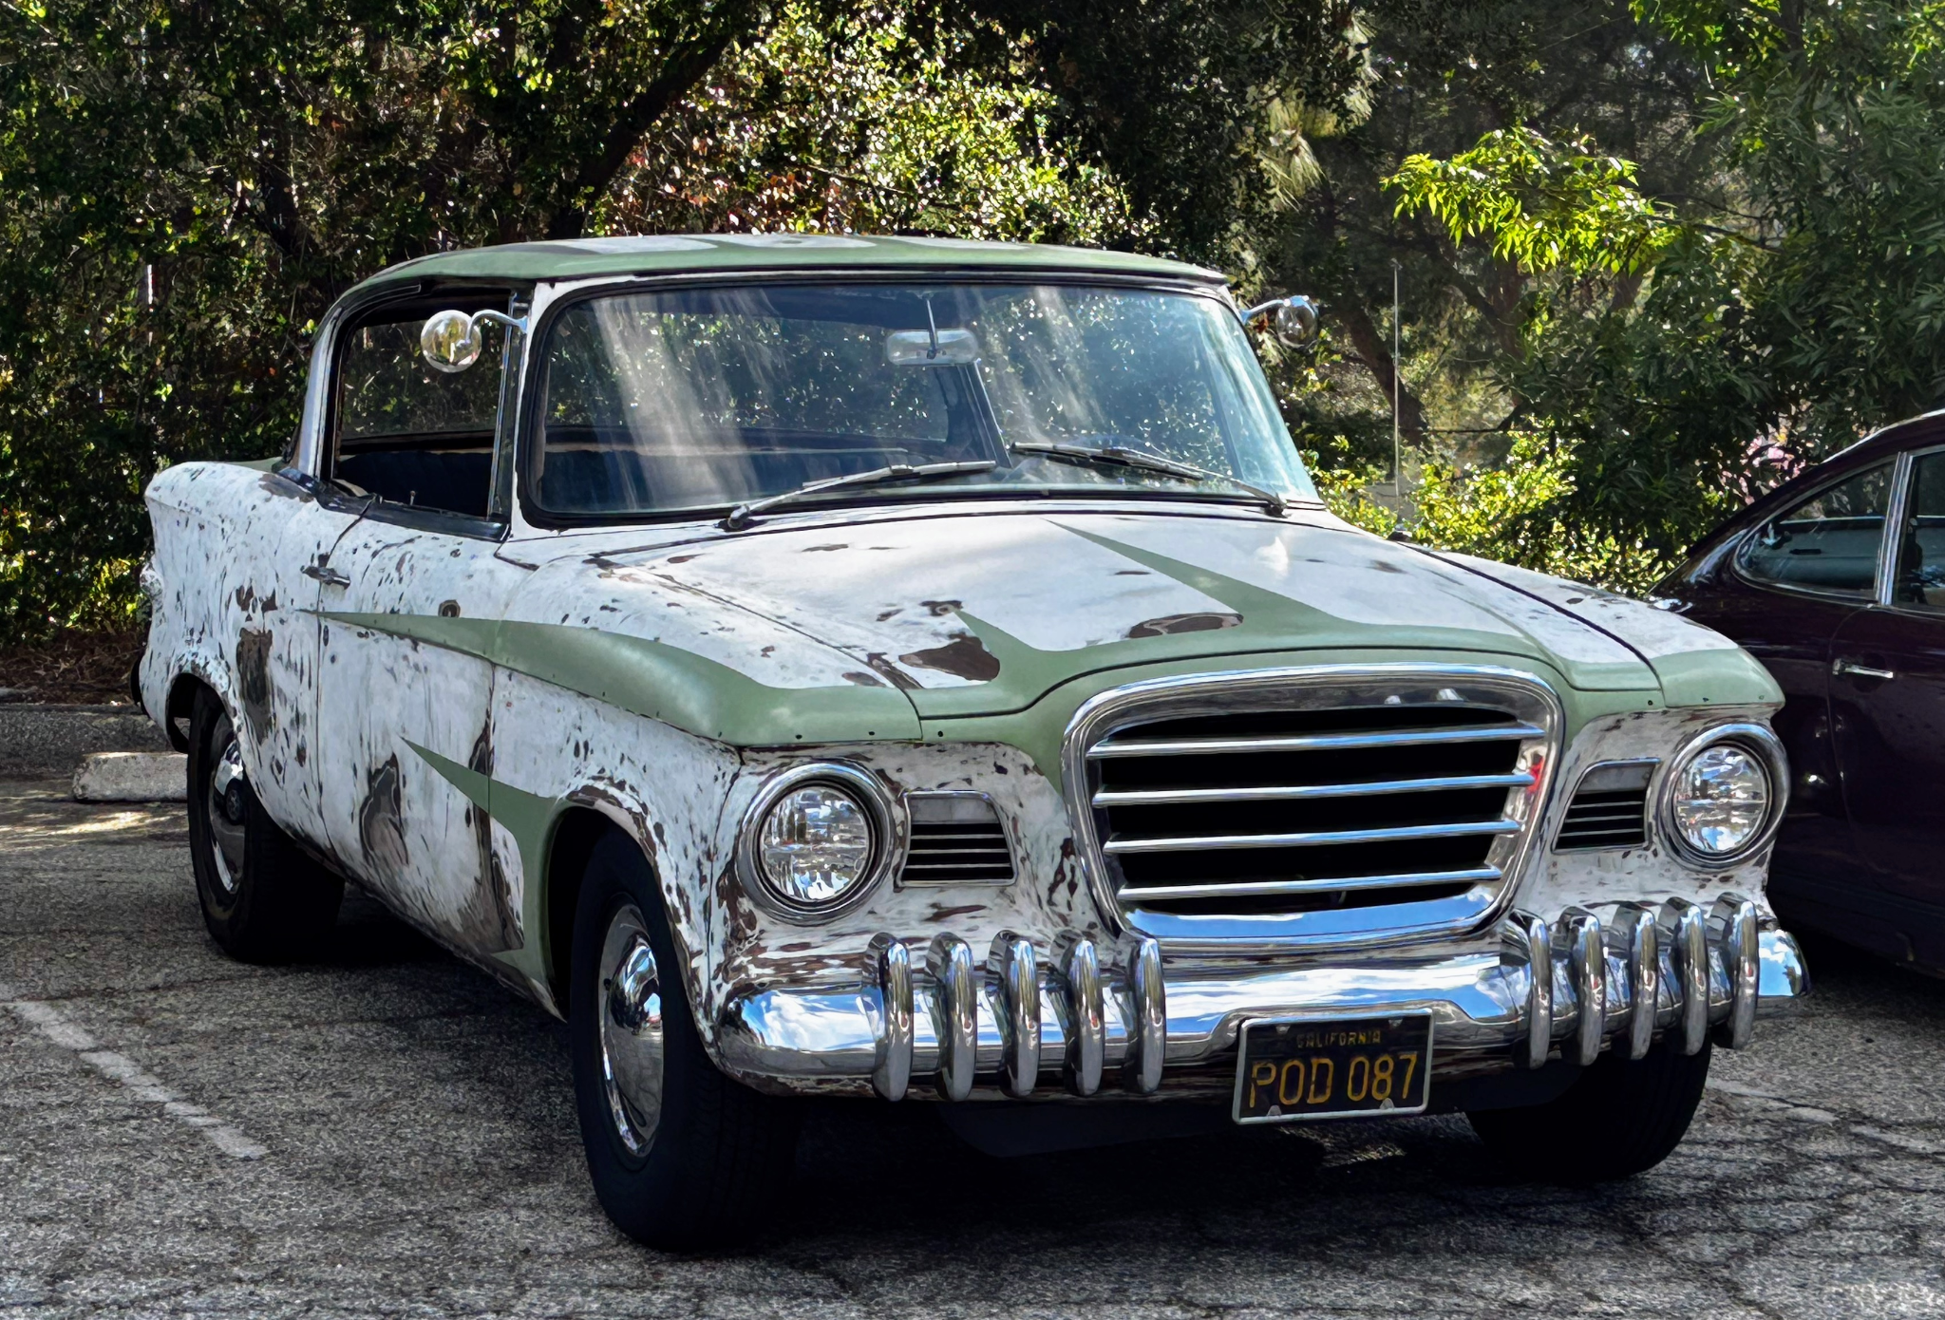
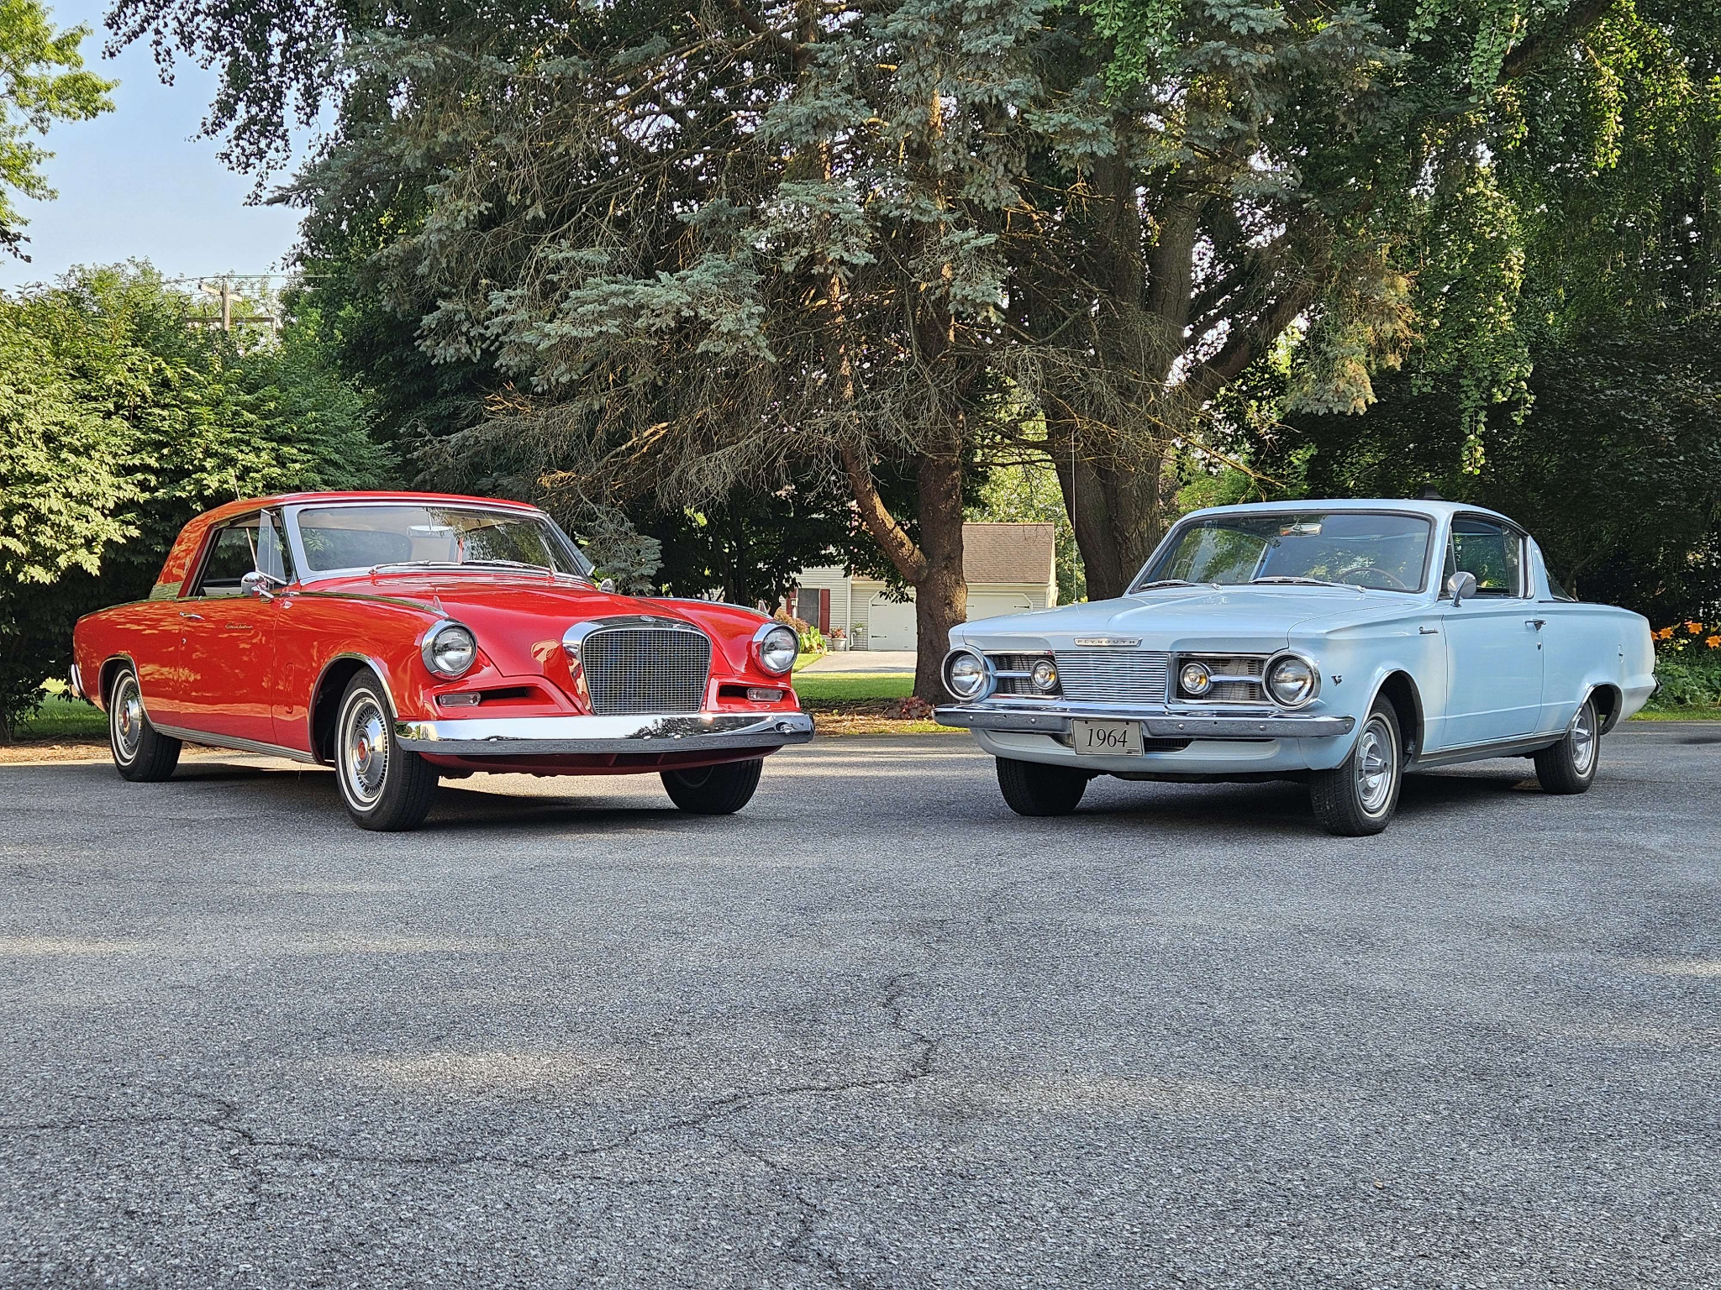
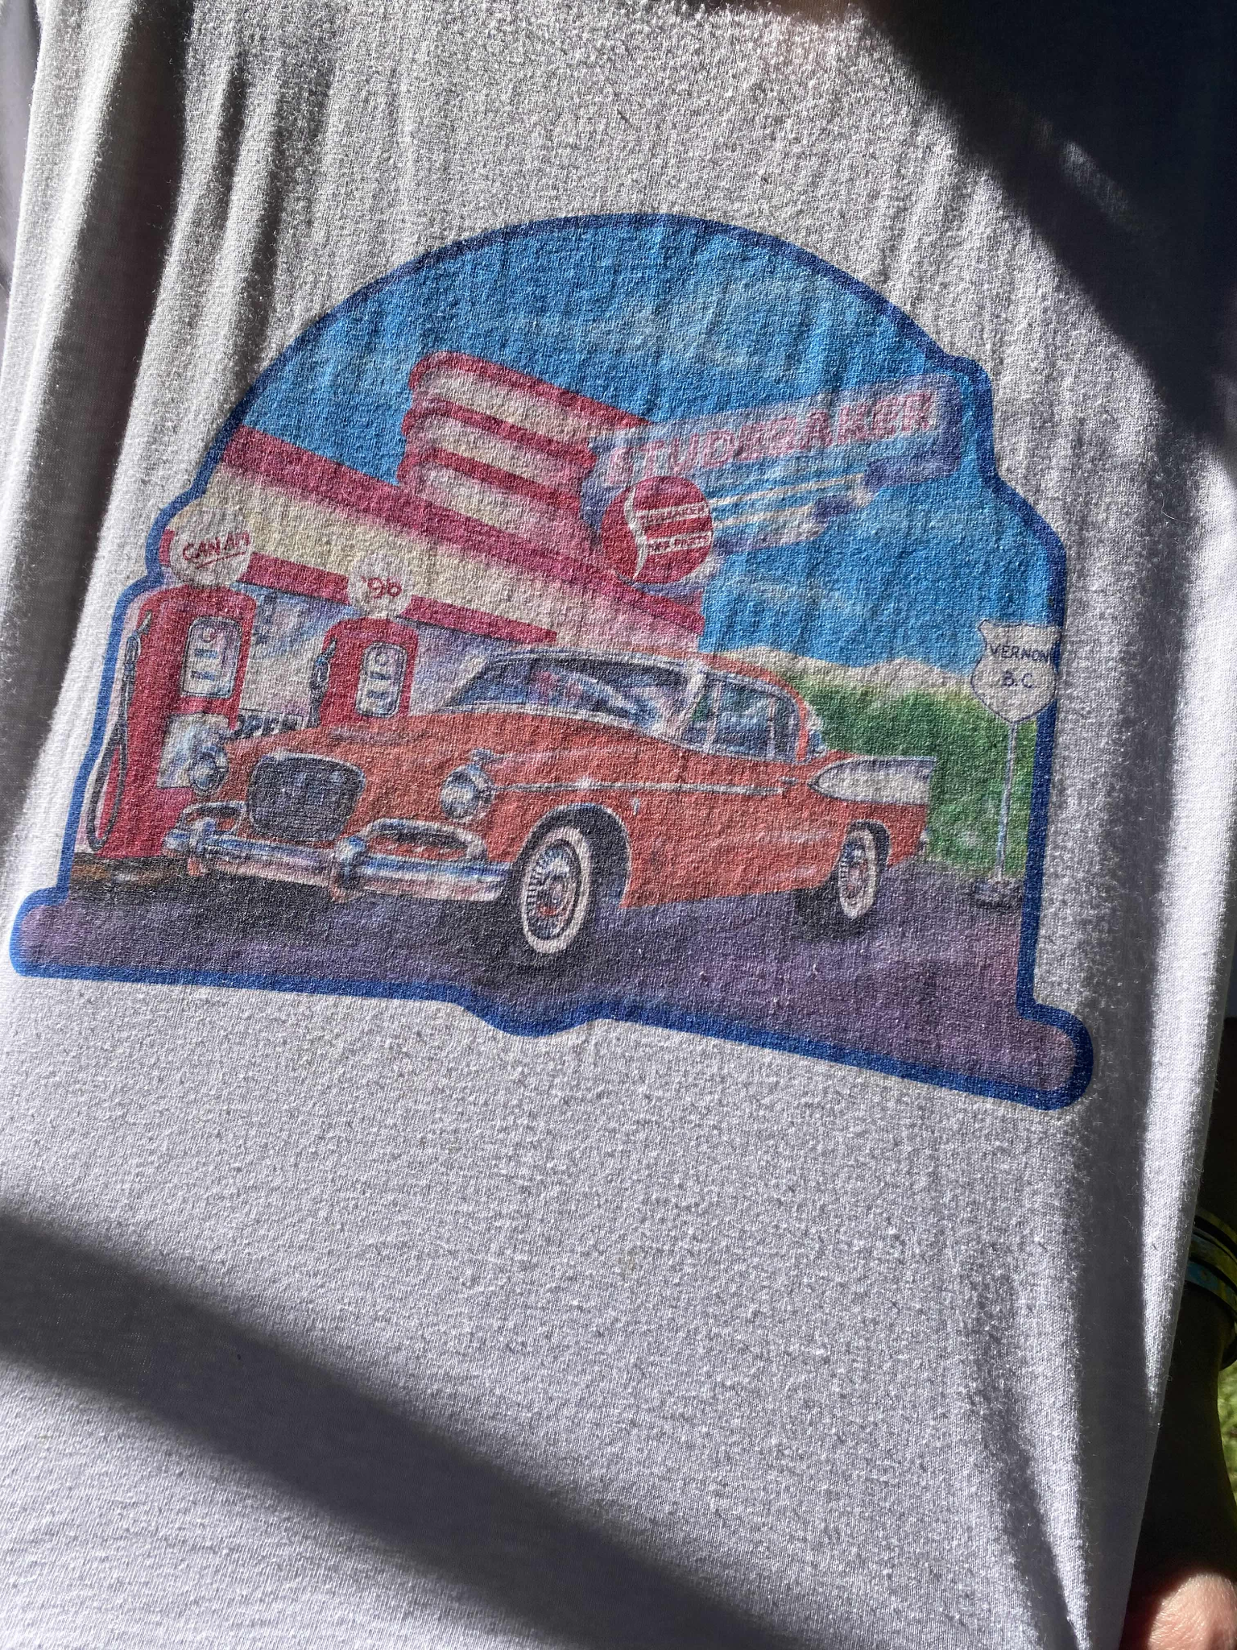

The stuff page
Creeg
Martin Luther
Luna Tuna

Slide 6

It’s been a fantastic year, here’s to many more.

Slide 7
Zine published by the Studebaker Blorbo Society. All rights reserved.
Except you can screenshot this if you want and share it with friends and do whatever you want actually.

